Slide 1
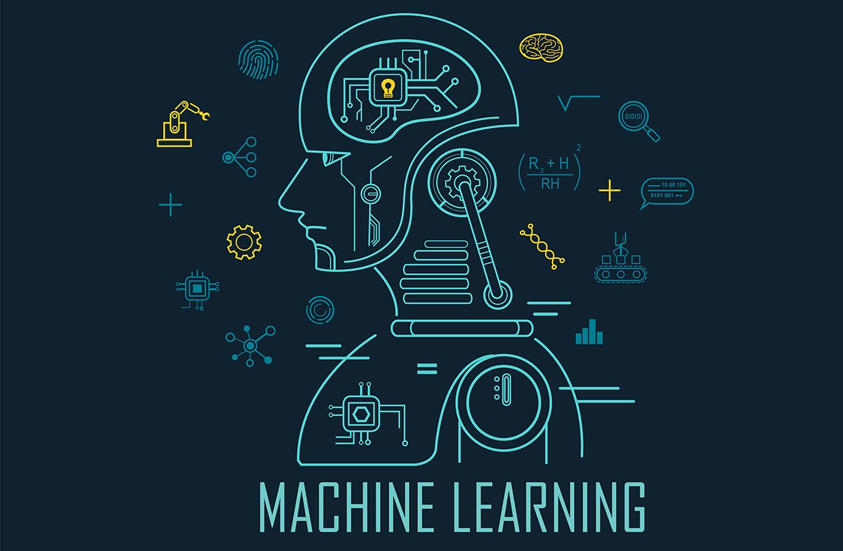
Introduction to Machine Learning
Dr. Hemachandran K

Slide 2
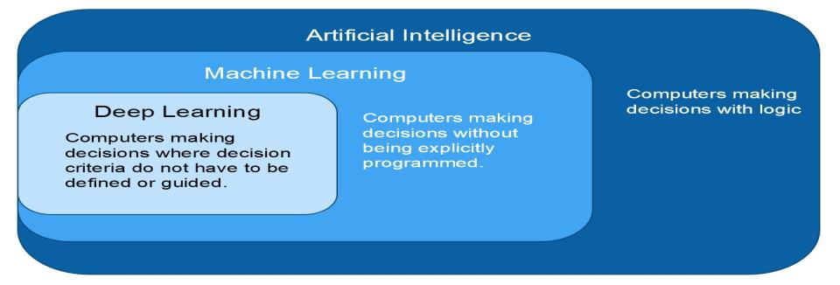
A.I, M.L, D.L, D.S. AI – Enables the machine to think ML- It provides the statistical tools to understand and analyse the data DL – Multi Neural Network Architecture DS – Will work with ML, DL and AI

Slide 3
Artificial Intelligence Applications
AI will transform the internet Technology areas with potential for paradigm shift:
• Computer vision
• Speech recognition & speech synthesis
• Language understanding: Machine translation; Web search; Dialog systems;
• Advertising
• Personalization/recommendation systems
• Robotics All this is hard: scalability, algorithms.

Slide 4
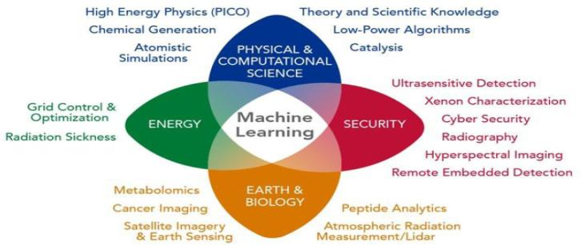
Role of Machine Learning in Different domains

Slide 5
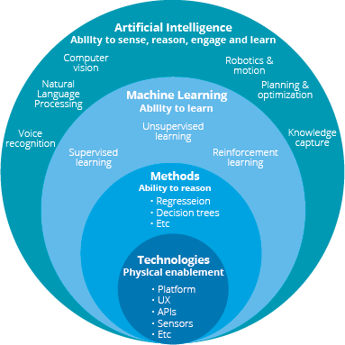

Slide 6
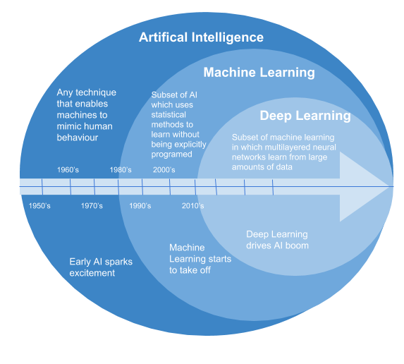

Slide 7
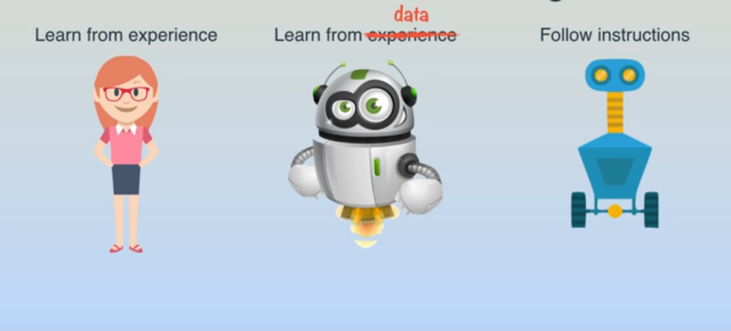
WHAT IS MACHINE LEARNING?

Slide 8
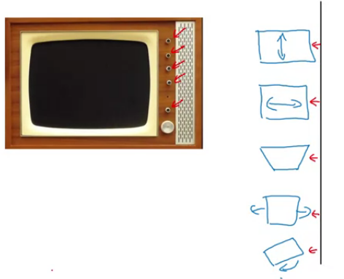
Machine Learning Strategy

Slide 9
Algorithm
Machine Learning
Data
Program
output
Data
Computer
Computer
output
Model

Slide 10
Data Statistics
Machine learning:- The ability to learn without being explicitly programmed. – Arthur Samuel(1959)
ML, AI & DL (Previously no cloud, high speed computers)
Hadoop, spark, BigData
Data Big rather than BigData
Exponential growth
Industry growth
Hot job

Slide 11
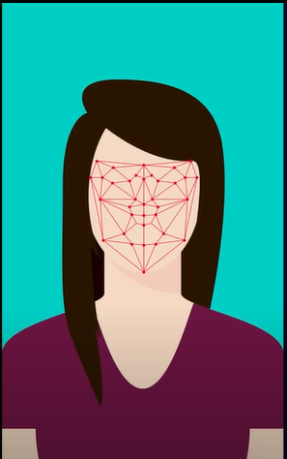
Real Time Example 1
Face Detection
Facebook, Google Image etc (Automatically tag)

Slide 12

Real Time Example 2
Speech Recognition & Speech To Text
iOS, Android, etc,.

Slide 13
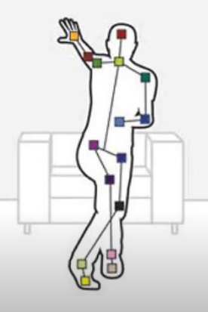
Real Time Example 3
Motion Detection& Gesture Analysis
Kinect – Microsoft X Box

Slide 14
Day to Day….
Amazon
Linkedin
Netflix

Slide 15
Data Preprocessing
1. Missing Values (In raw data some missing values will be there)
Categorical
Regression(continuous )
2. Categorical Data (male and female)
3. Data split for train and test
4. Feature Scaling

Slide 16
Missing Values (Null values)
Mean = Average (sum /no. of value)
Median = Middle Value
Mode = Most frequent (which value repeated more number of times
Advance Method
Algorithm

Slide 17
Mean
Sum = 5+5+5+5+5 = 25
Mean = 25/5 = 5

Slide 18
Median (middle value)
Values = 1,2,3,4,5,6,7,8,9
Median = 5

Slide 19
Mode
Values = 1,2,3,3,2,4,1,3,4
Mode = 3

Slide 20
Applications of mean, median and mode
5 friends were going to restaurant to have dinner. Each one ordered a dish. Finally the bill amount is (dish1: Rs. 20, dish2: Rs.20, dish 3: Rs.30, dish4: Rs.60, dish5: Rs.70 ) Total: Rs.200. To pay the bill which is best mean, median or mode?
In a class the student strength is 7 and the marks obtained in a particular subject is {30,31,32,35,37,38,99}. The faculty want to know how the class was faring overall. For this which is best mean, median or mode?
Food grain produce
Year | 2000 | 2001 | 2002 | 2003 | 2004 | 2005 | 2006
Prodn(Metric Tons) | 46 | 47 | 5 | 2 | 44 | 45 | 45.5

Slide 21
Continue…
You are running an ice cream parlor in that you are selling 4 flavours of ice cream strawberry, vanilla, butter scotch, black current. With a past one week data you need to identify which is the best selling ice cream
Strawberry | Vanilla | Butter Scotch | Black Current
40 | 20 | 50 | 10

Slide 22
Advance Method
By using Decision Tree Algorithm or random forest we can fill the missing data.
Whenever you have categorical data don’t use mean. So please choose mode or median.

Slide 23
Categorical Data
Text Data → Label Encoding (low weightage and high weightage problem). To solve this problem we need to go with One Hot Encoding
Apple - 0
Orange -3
Banana -1
Grape -2
Apple -0
Grape -2
Banana -1
Orange -3
Apple /0 | Banana / 1 | Grape / 2 | Orange / 3
1 | 0 | 0 | 0
0 | 0 | 0 | 1
0 | 1 | 0 | 0
1 | 0 | 0 | 0
0 | 0 | 1 | 0
0 | 1 | 0 | 0
0 | 0 | 0 | 1

Slide 24
Train and Test Split
Issues
More & Less Trained Model – Performance issues
Testing a model
Solution
Data split based on availability and industry standard
Allocation: 80 -20 % or 70-30%
Xtrain, Ytrain, Xtest and Y test

Slide 25
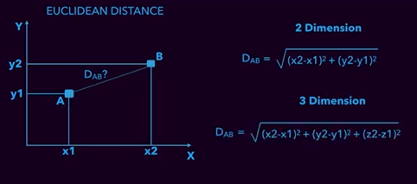
Feature Scaling
Why?
Dataset in one scale to minimise the distance, less domination
Fast computation-less memory(Eg: Decision Tree)
Euclidean Distance (distance between two points AB

Slide 26
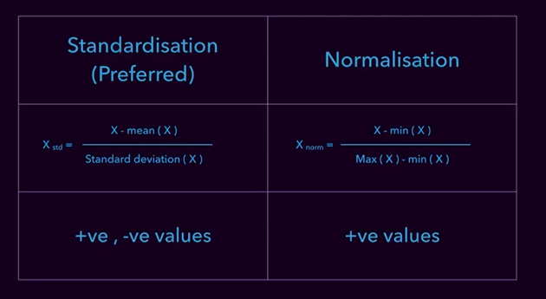
Technique

Slide 27
Supervised Learning
A machine is trained using labeled data.
Data has been tagged with the correct answer.
The algorithm predicts outcomes for unforeseen data by learning from labeled training data.
Types: Regression
Regression it helps in predict the price of a house based on its locality, size etc.
Logistic Regression
The output has discrete values based on a set of independent variables

Slide 28
Continues…
Classification
grouping the data into classes
Naïve Bayesian Model
It is a method of assigning class labels using a direct acyclic graph
Decision Trees
It is a flowchat-like model that contains conditional control statements, comprising decisions and their probable consequences.
Random Forest
Multiple decision tress and outputs a classification of the individual trees.

Slide 29
continues
Neural Networks
This algorithm is designed to cluster raw input, recognize patterns, or interpret sensory data
S
Support vector machines
SVM separates hyperplanes, which makes it a discriminative classifier.

Slide 30
Unsupervised Learning
In which models are not supervised using training dataset. Instead, models itself find the hidden patterns and insights from the given data.
Clustering
Grouping the object which has same similarities.
Association:
It is used in finding the relationship between variables in the large database. Eg : bread / jam

Slide 31
Continues…
K-means clustering
KNN
Hierarchal Clustering
Principle component analysis
Apriori algorithm

Slide 32
Reinforcement learning
Trial and error method
Markov decision process – maximum rewards over a time
Q learning – is to learn quality of actions telling an agent what action to take under what circumstances.

